Slide 1
Spring MVC
Computación en Internet II
2023-2

Slide 2
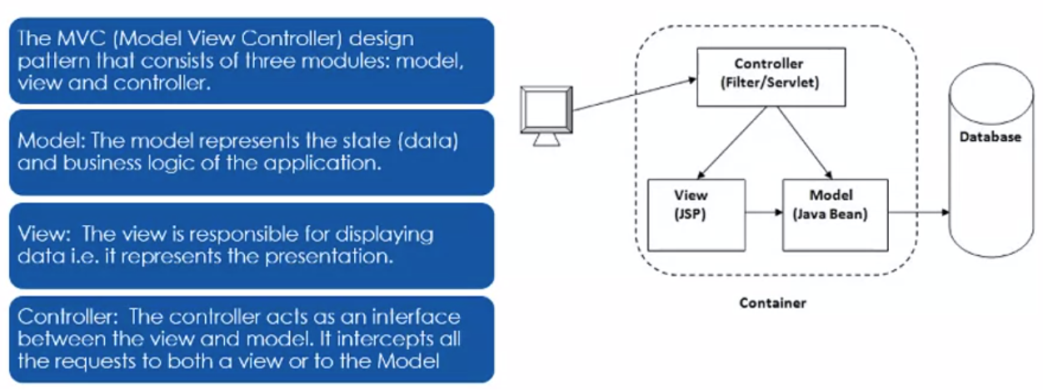
Model View Controller - Key Architectural Pattern

Slide 3
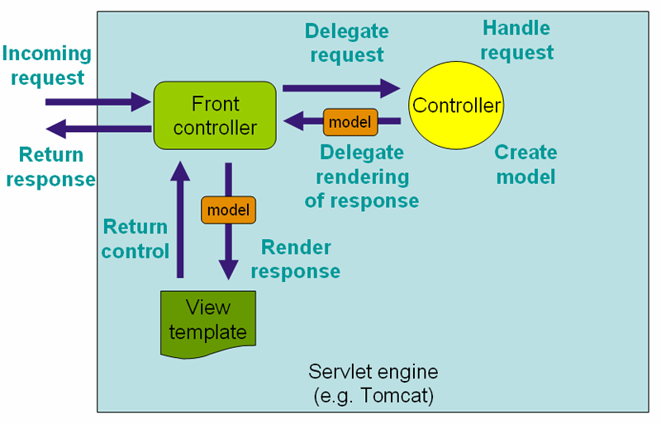
Model View Controller - Key Architectural Pattern
DispatcherServlet is the front controller class to take all requests and start processing them.
The DispatcherServlet is an actual Servlet (it inherits from the HttpServlet base class), and as such is declared in the web.xml of your web application.

Slide 4
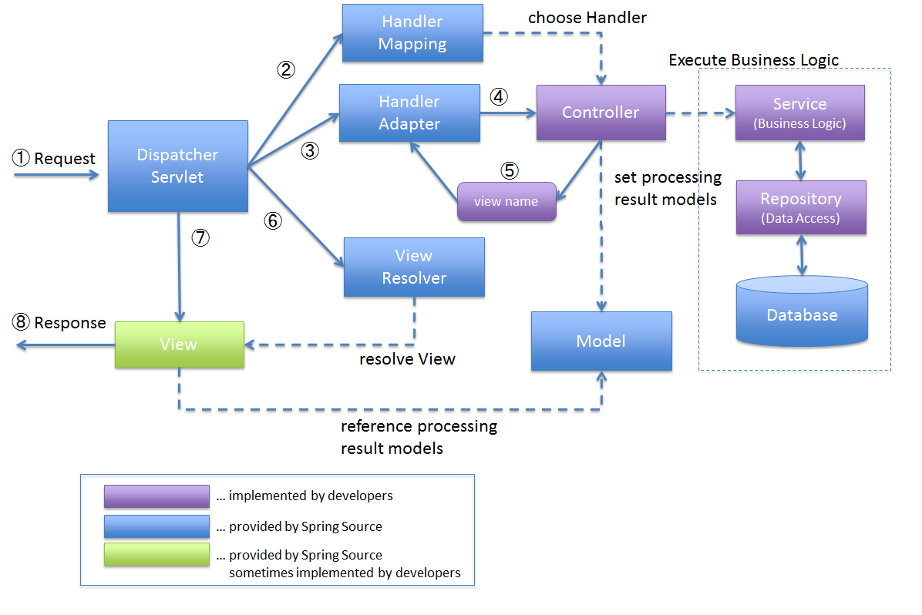
Spring MVC Processing sequence

Slide 5
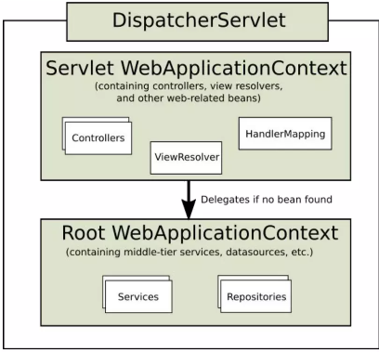
Web Application Context
In the Web MVC framework, each DispatcherServlet has its own WebApplicationContext, which inherits all the beans already defined in the Root WebApplicationContext.
Spring MVC looks for a file named [servlet-name]-servlet.xml in the WEB-INF directory of your web application and creates the beans defined there, overriding the definitions of any beans defined with the same name in the global scope.

Slide 6
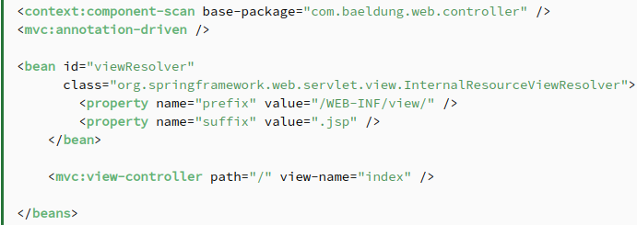
Basic Configuration - XML
Spring MVC supports 2 types of configurations:
XML Configuration
Java-based Configuration

Slide 7
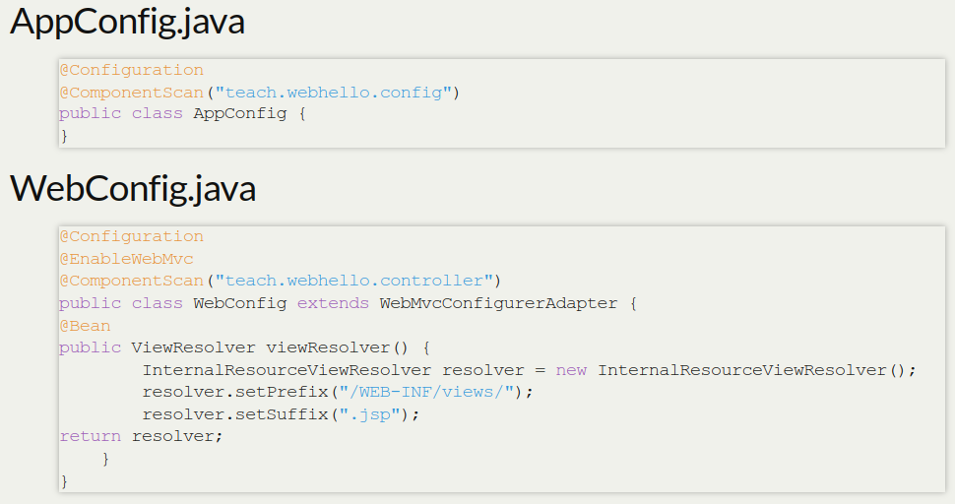
Basic Configuration - Java

Slide 8
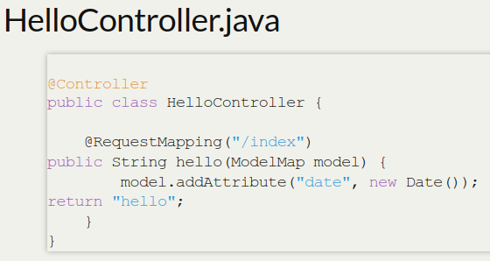
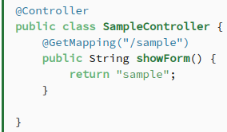
Controllers
The central components of MVC
Simply add @Controller annotation to a class
Use @RequestMapping to map methods to url

Slide 9
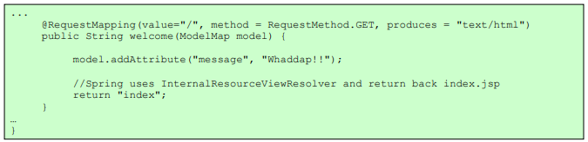
More detailed Url Mapping
@RequestMapping also accepts the following parameters:
method (GET/POST/PUT/DELETE...)
produces (mimeType)
consumes (mimeType)
Params
headers

Slide 10
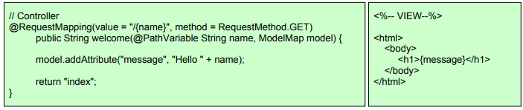
Model
Controllers and view share a Java object referred as model, (‘M’ in MVC)
A model can be of the type Model or can be a Map that can represent the model.
The view uses this to display dynamic data that has been given by the controller

Slide 11
@ModelAttribute from Controller
You can also use @ModelAttribute in controller to directly load URL value into the model
A Model can represent objects that can be retrieved from database or files as well
Model should not have logic, rather the controller should get the model and “transform” the model based on the request, while sending it to the View

Slide 12
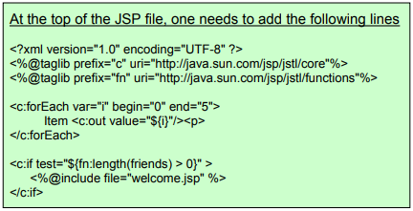
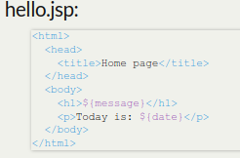
View
Spring MVC integrates with many view technologies: JSP, Velocity, Freemarker, JasperReports.
Values sent to controller with POST or GET as usual
Values made available to the view by the controller

Slide 13
@REQUESTMAPPING
URI templates can be used for convenient access to selected parts of a URL in a @RequestMapping method.
A URI Template is a URI-like string, containing one or more variable names. When you substitute values for these variables, the template becomes a URI.
For example, the URI Template http://www.example.com/users/{userId} contains the variable userId. Assigning the value fred to the variable yields http://www.example.com/users/fred.

Slide 14
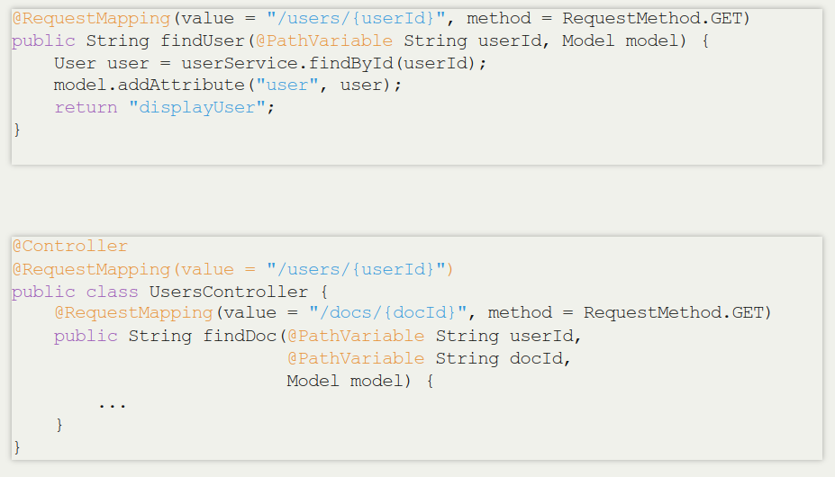
@REQUESTMAPPING

Slide 15
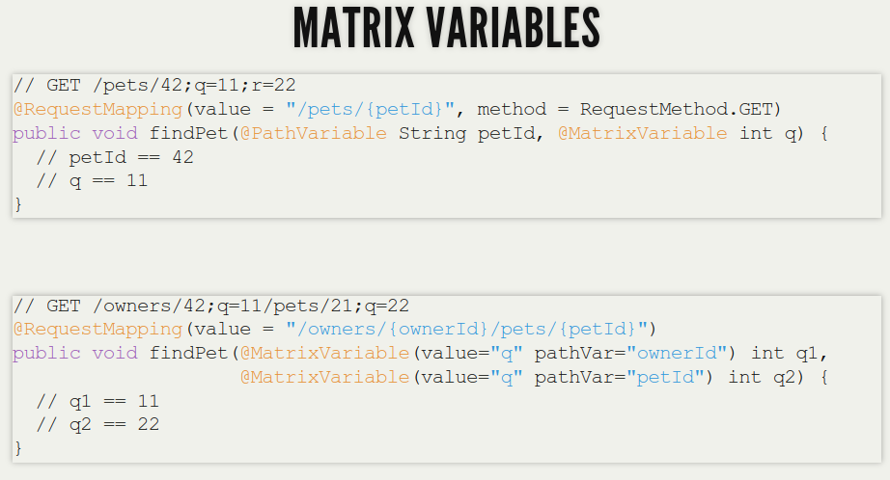
@REQUESTMAPPING

Slide 16
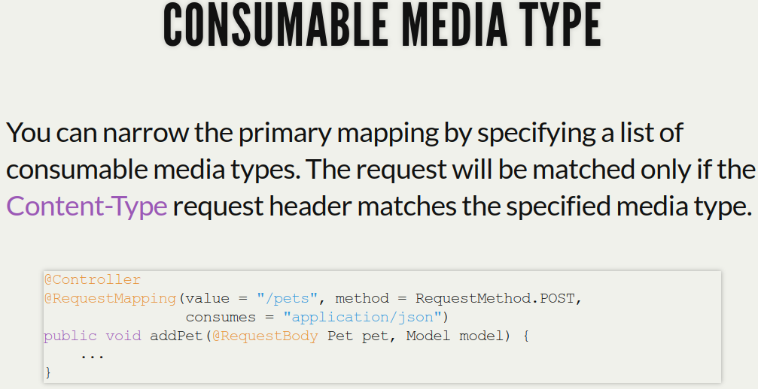
@REQUESTMAPPING

Slide 17
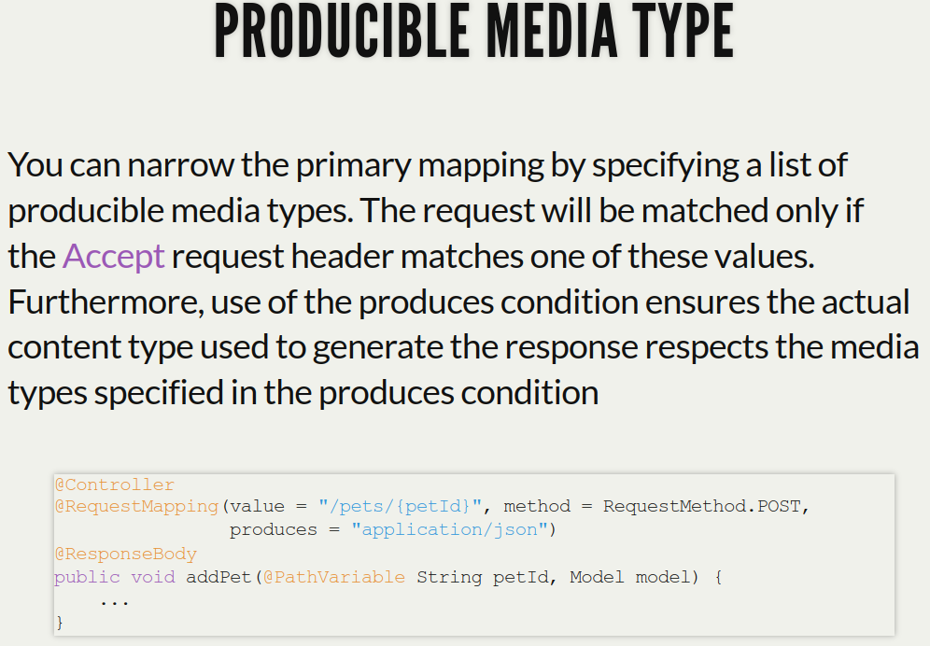
@REQUESTMAPPING

Slide 18
References
https://docs.spring.io/spring-framework/docs/3.2.x/spring-framework-reference/html/mvc.html
https://terasolunaorg.github.io/guideline/1.0.1.RELEASE/en/Overview/SpringMVCOverview.htm
https://www.baeldung.com/spring-mvc-tutorial

